Slide 1

Notes:
Apex Studio LLC investor deck

Slide 2
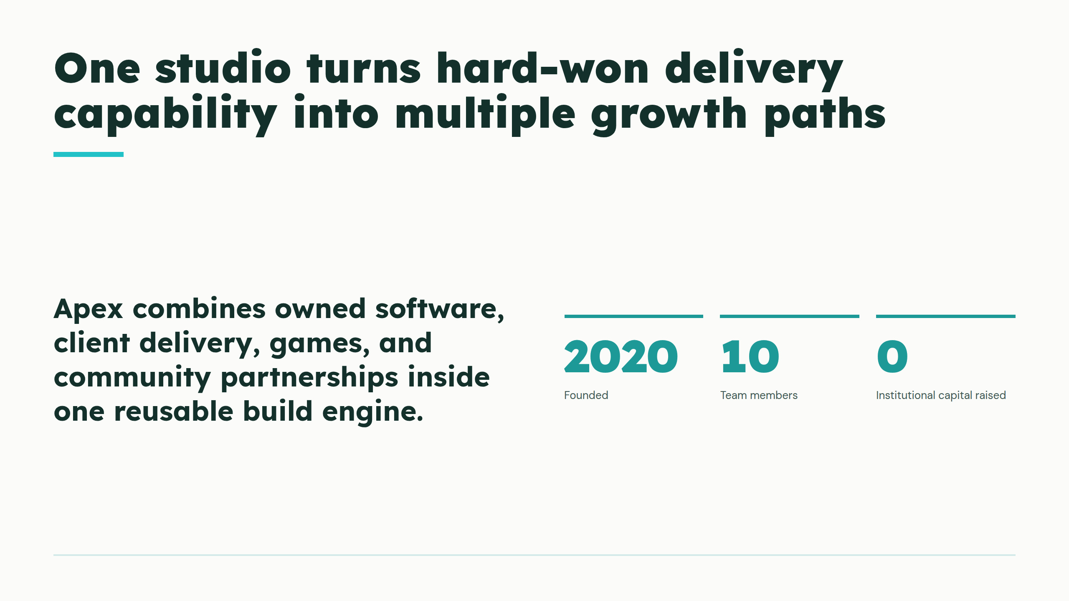
Notes:
One studio turns hard-won delivery capability into multiple growth paths

Slide 3
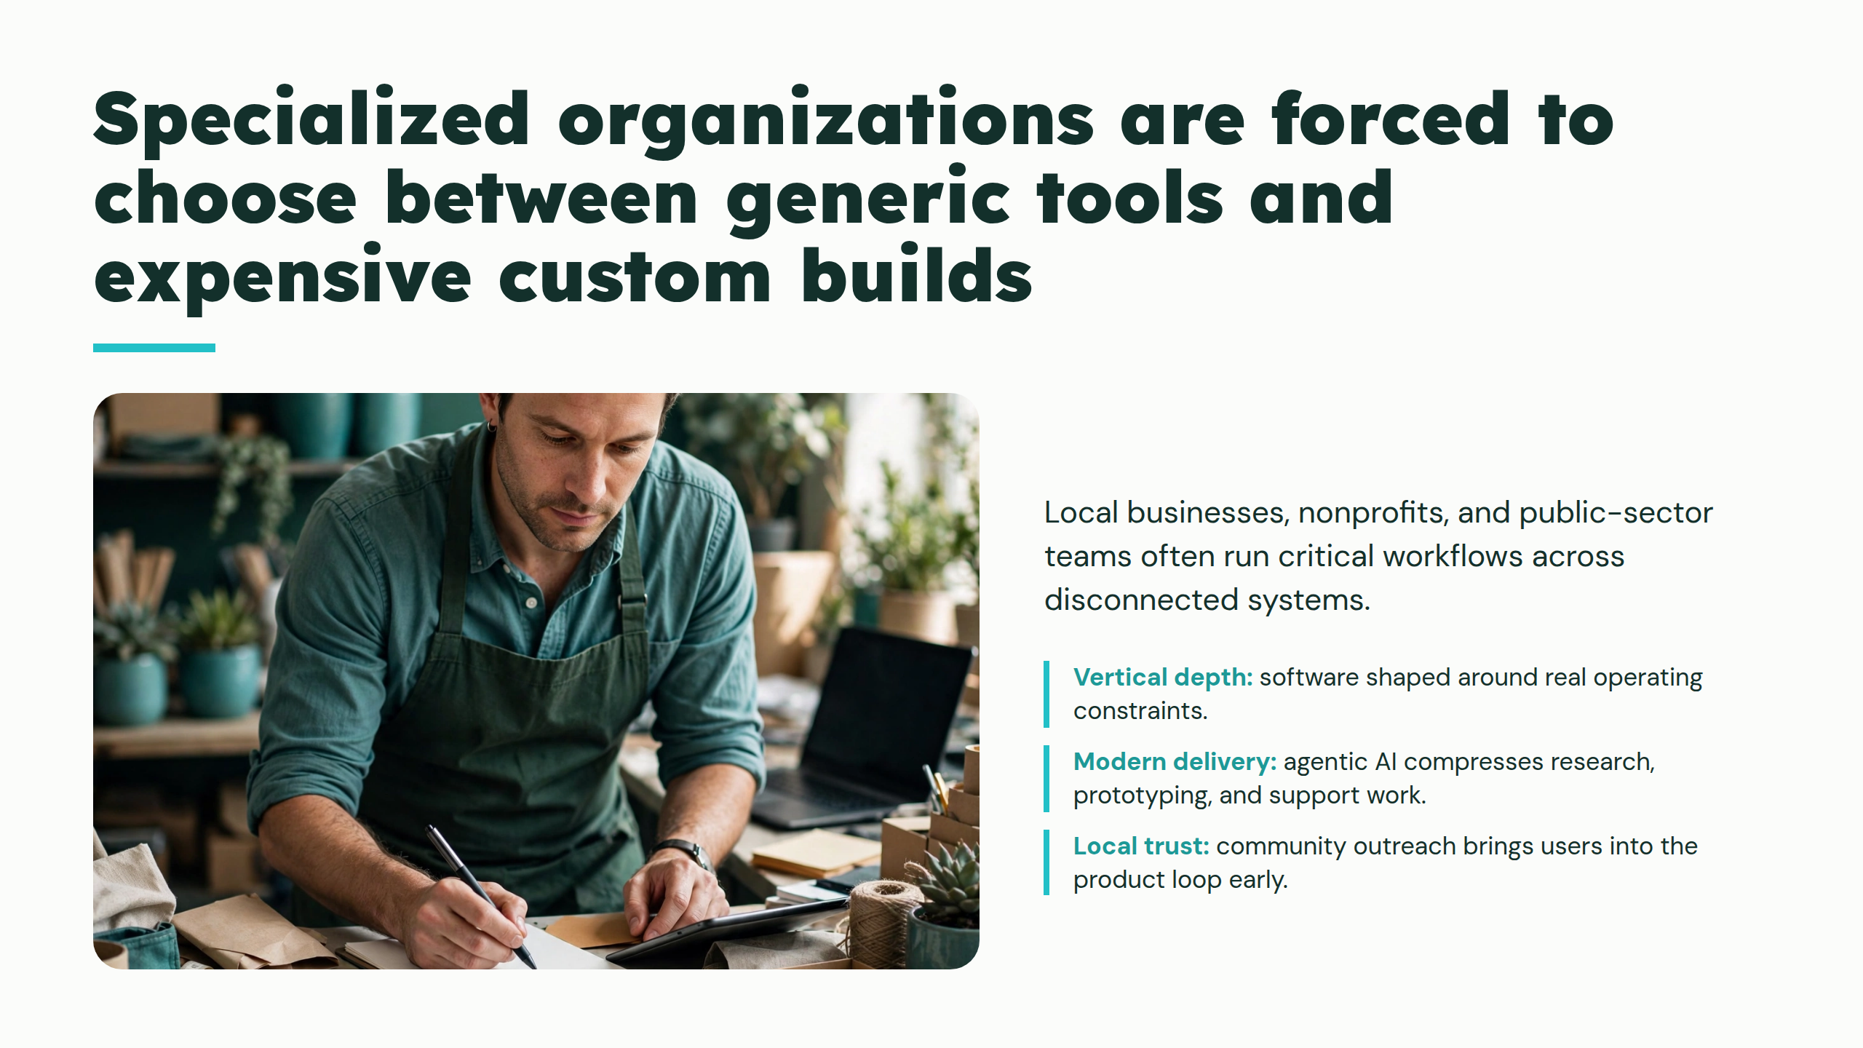
Notes:
Specialized organizations are forced to choose between generic tools and expensive custom builds

Slide 4
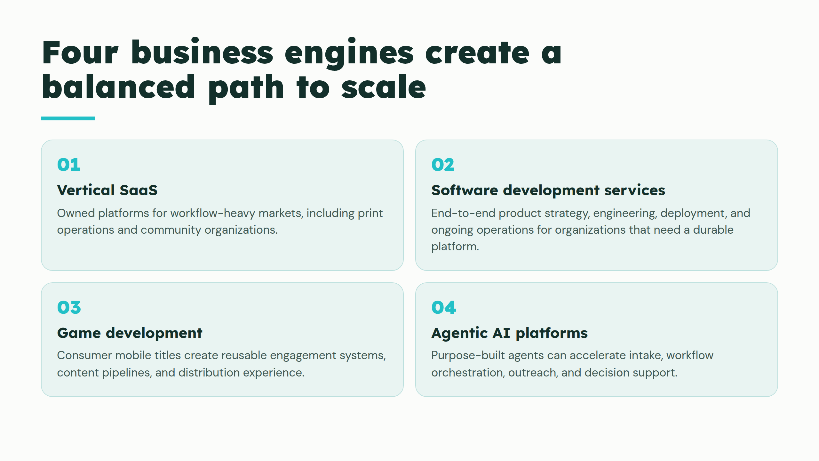
Notes:
Four business engines create a balanced path to scale

Slide 5
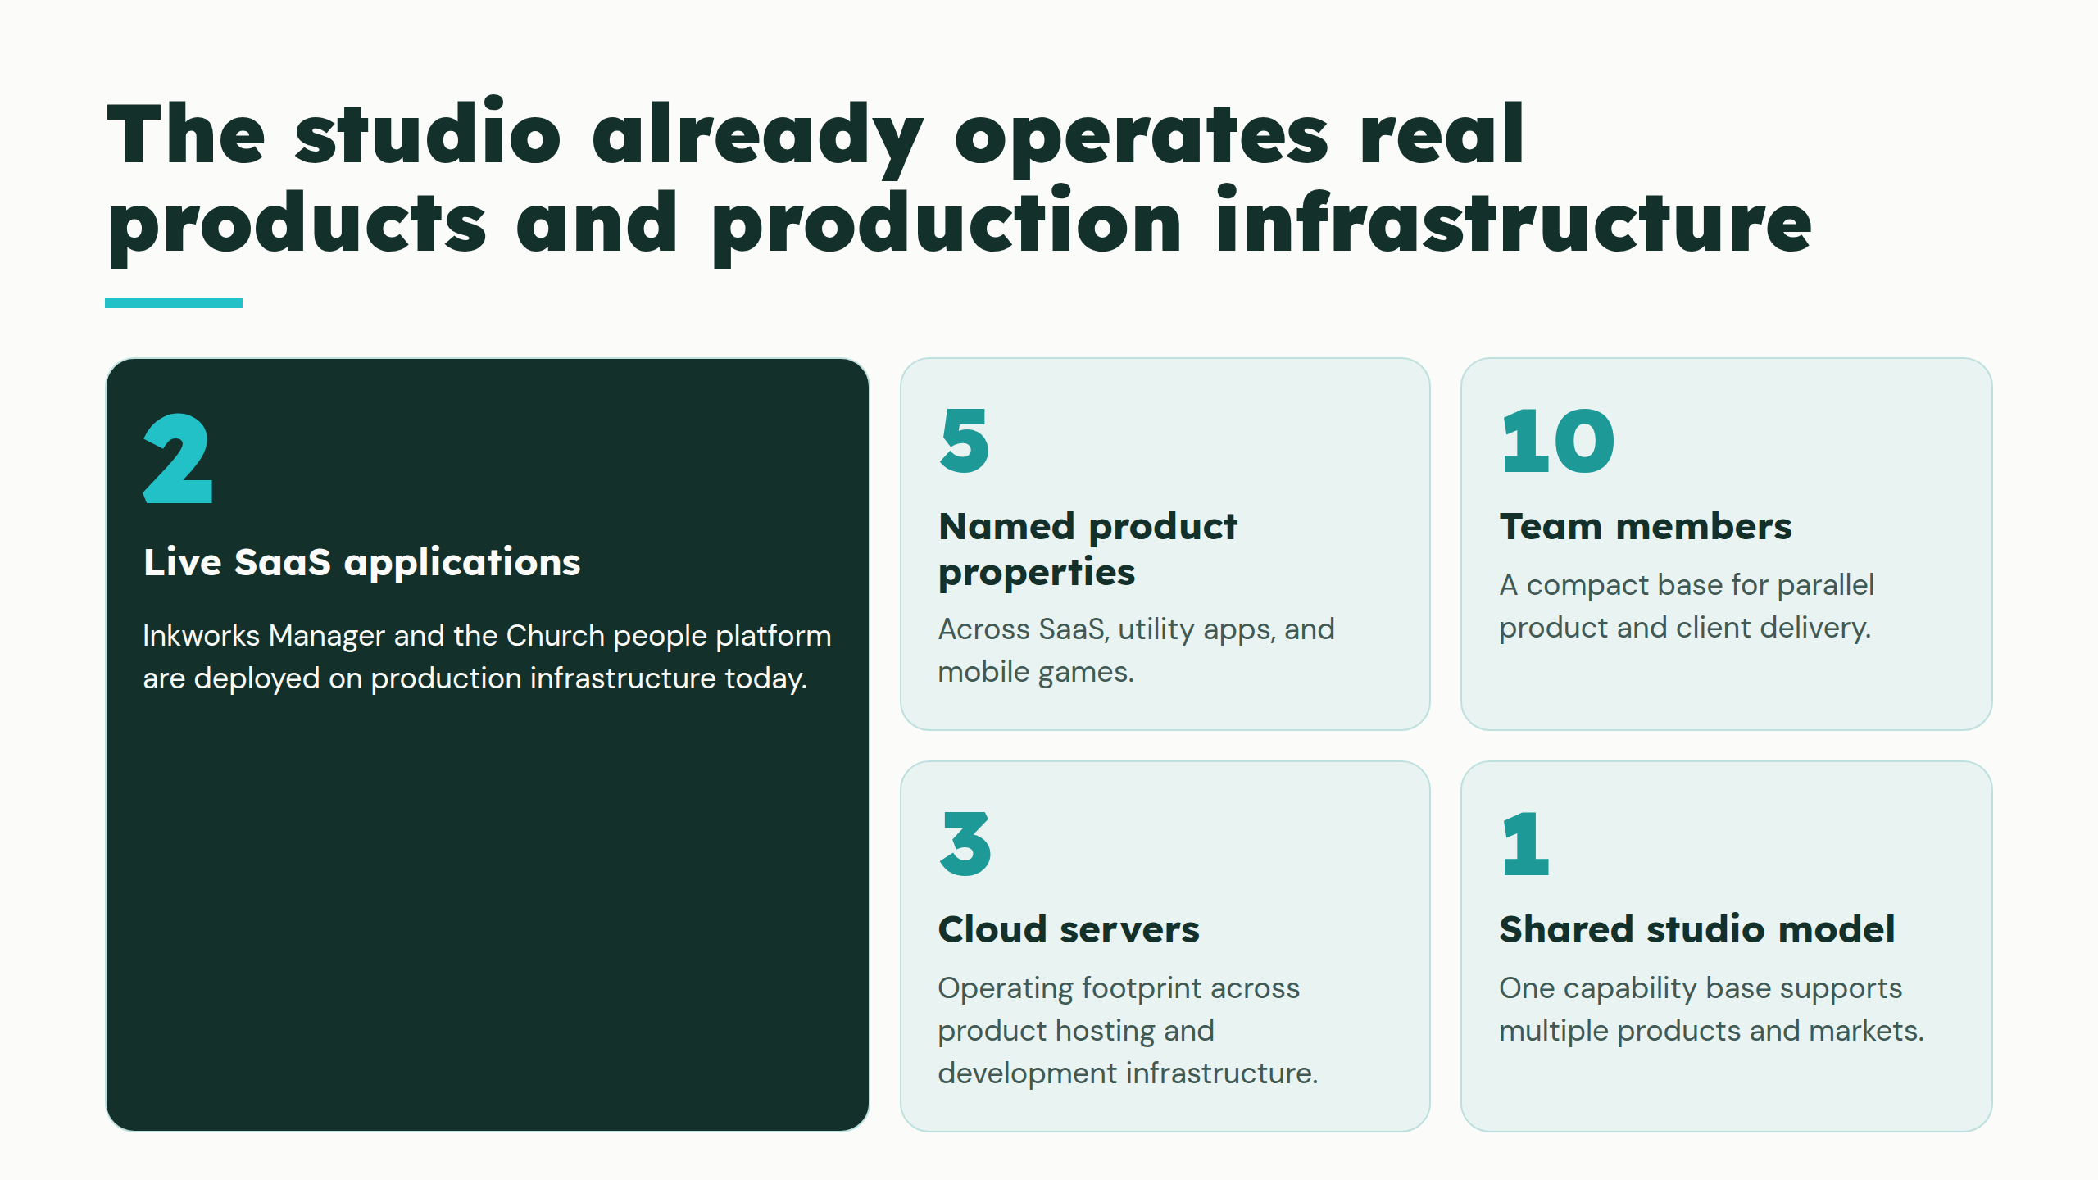
Notes:
The studio already operates real products and production infrastructure

Slide 6
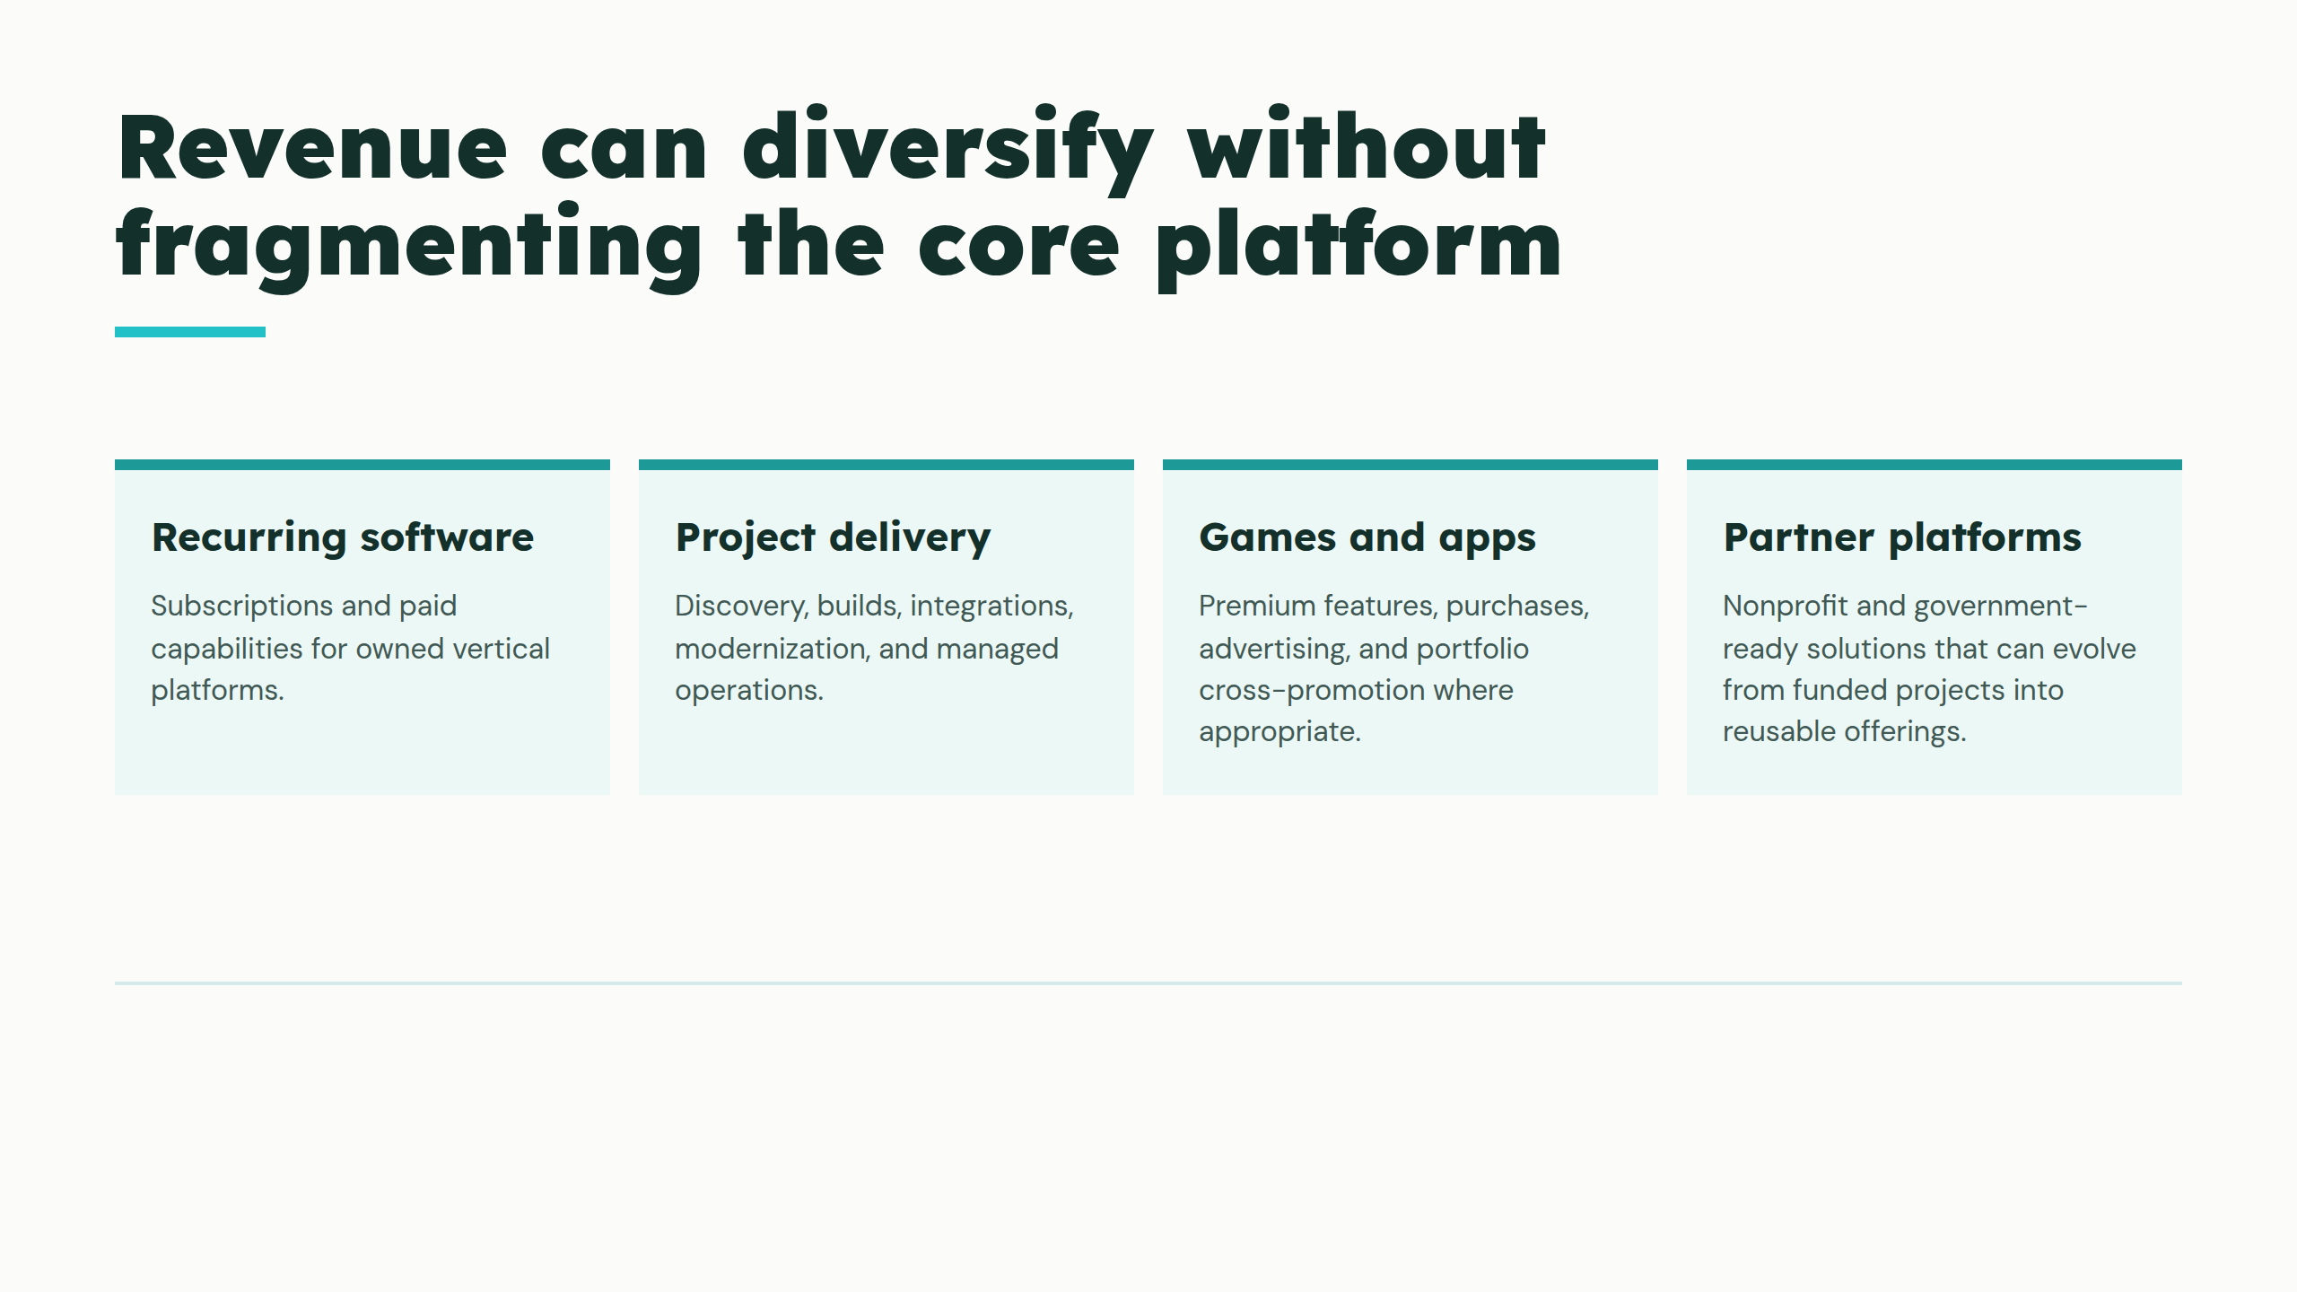
Notes:
Revenue can diversify without fragmenting the core platform

Slide 7
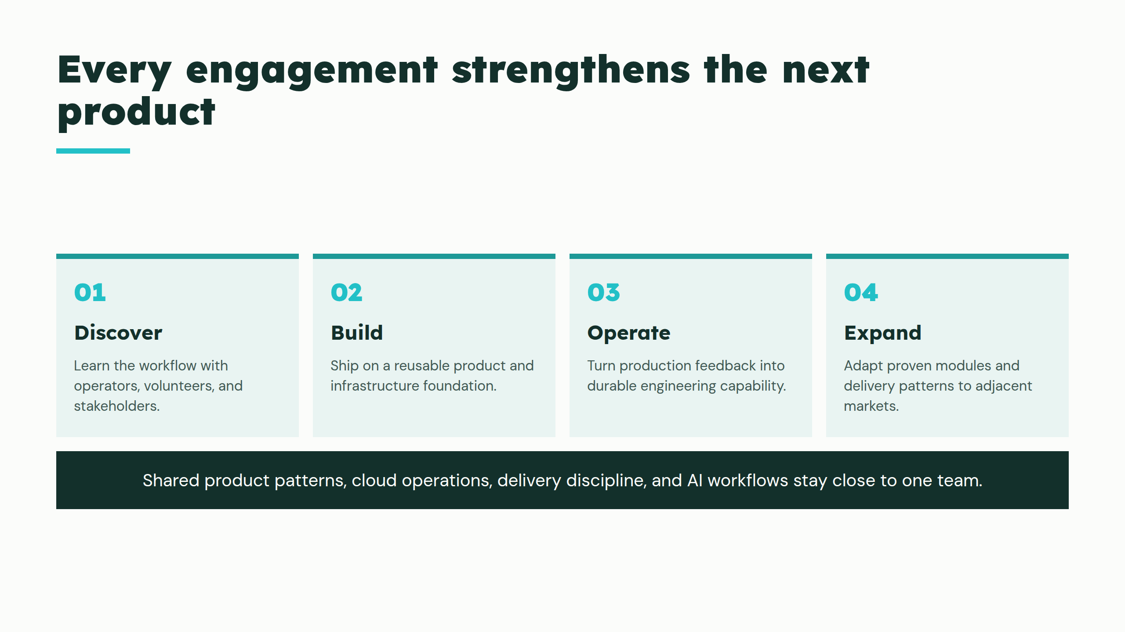
Notes:
Every engagement strengthens the next product

Slide 8
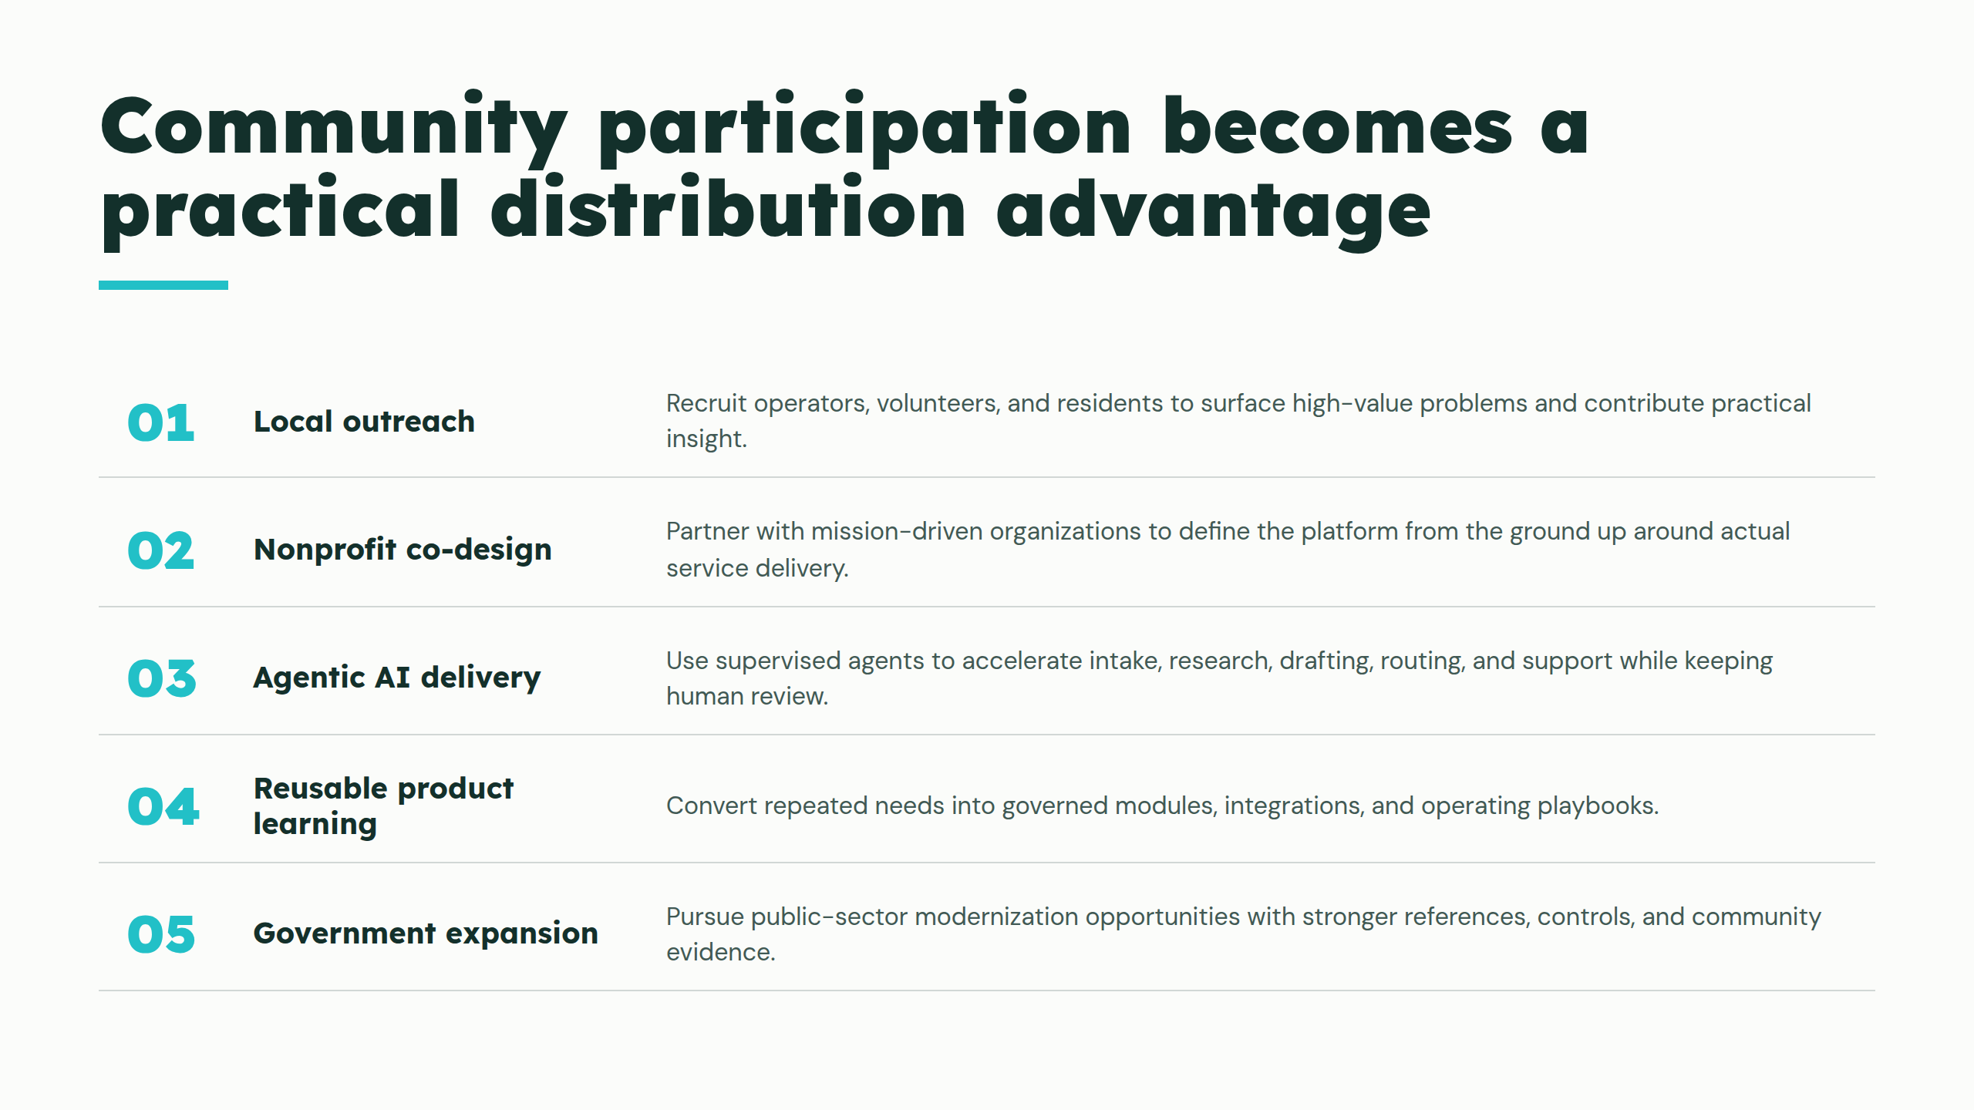
Notes:
Community participation becomes a practical distribution advantage

Slide 9
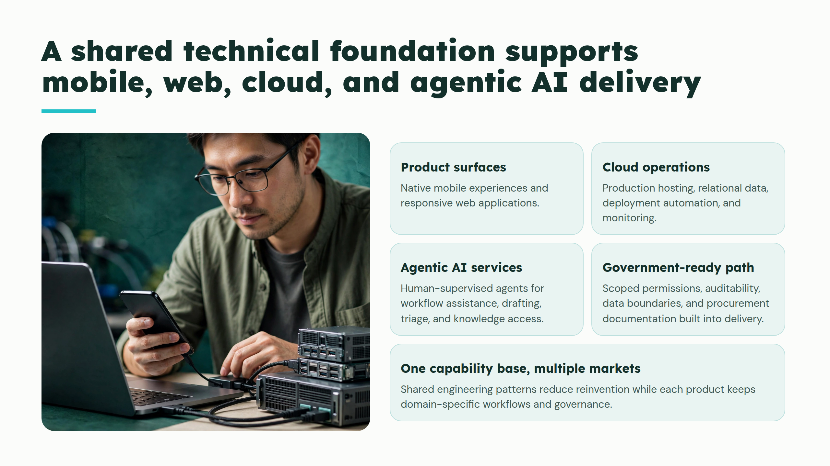
Notes:
A shared technical foundation supports mobile, web, cloud, and agentic AI delivery

Slide 10
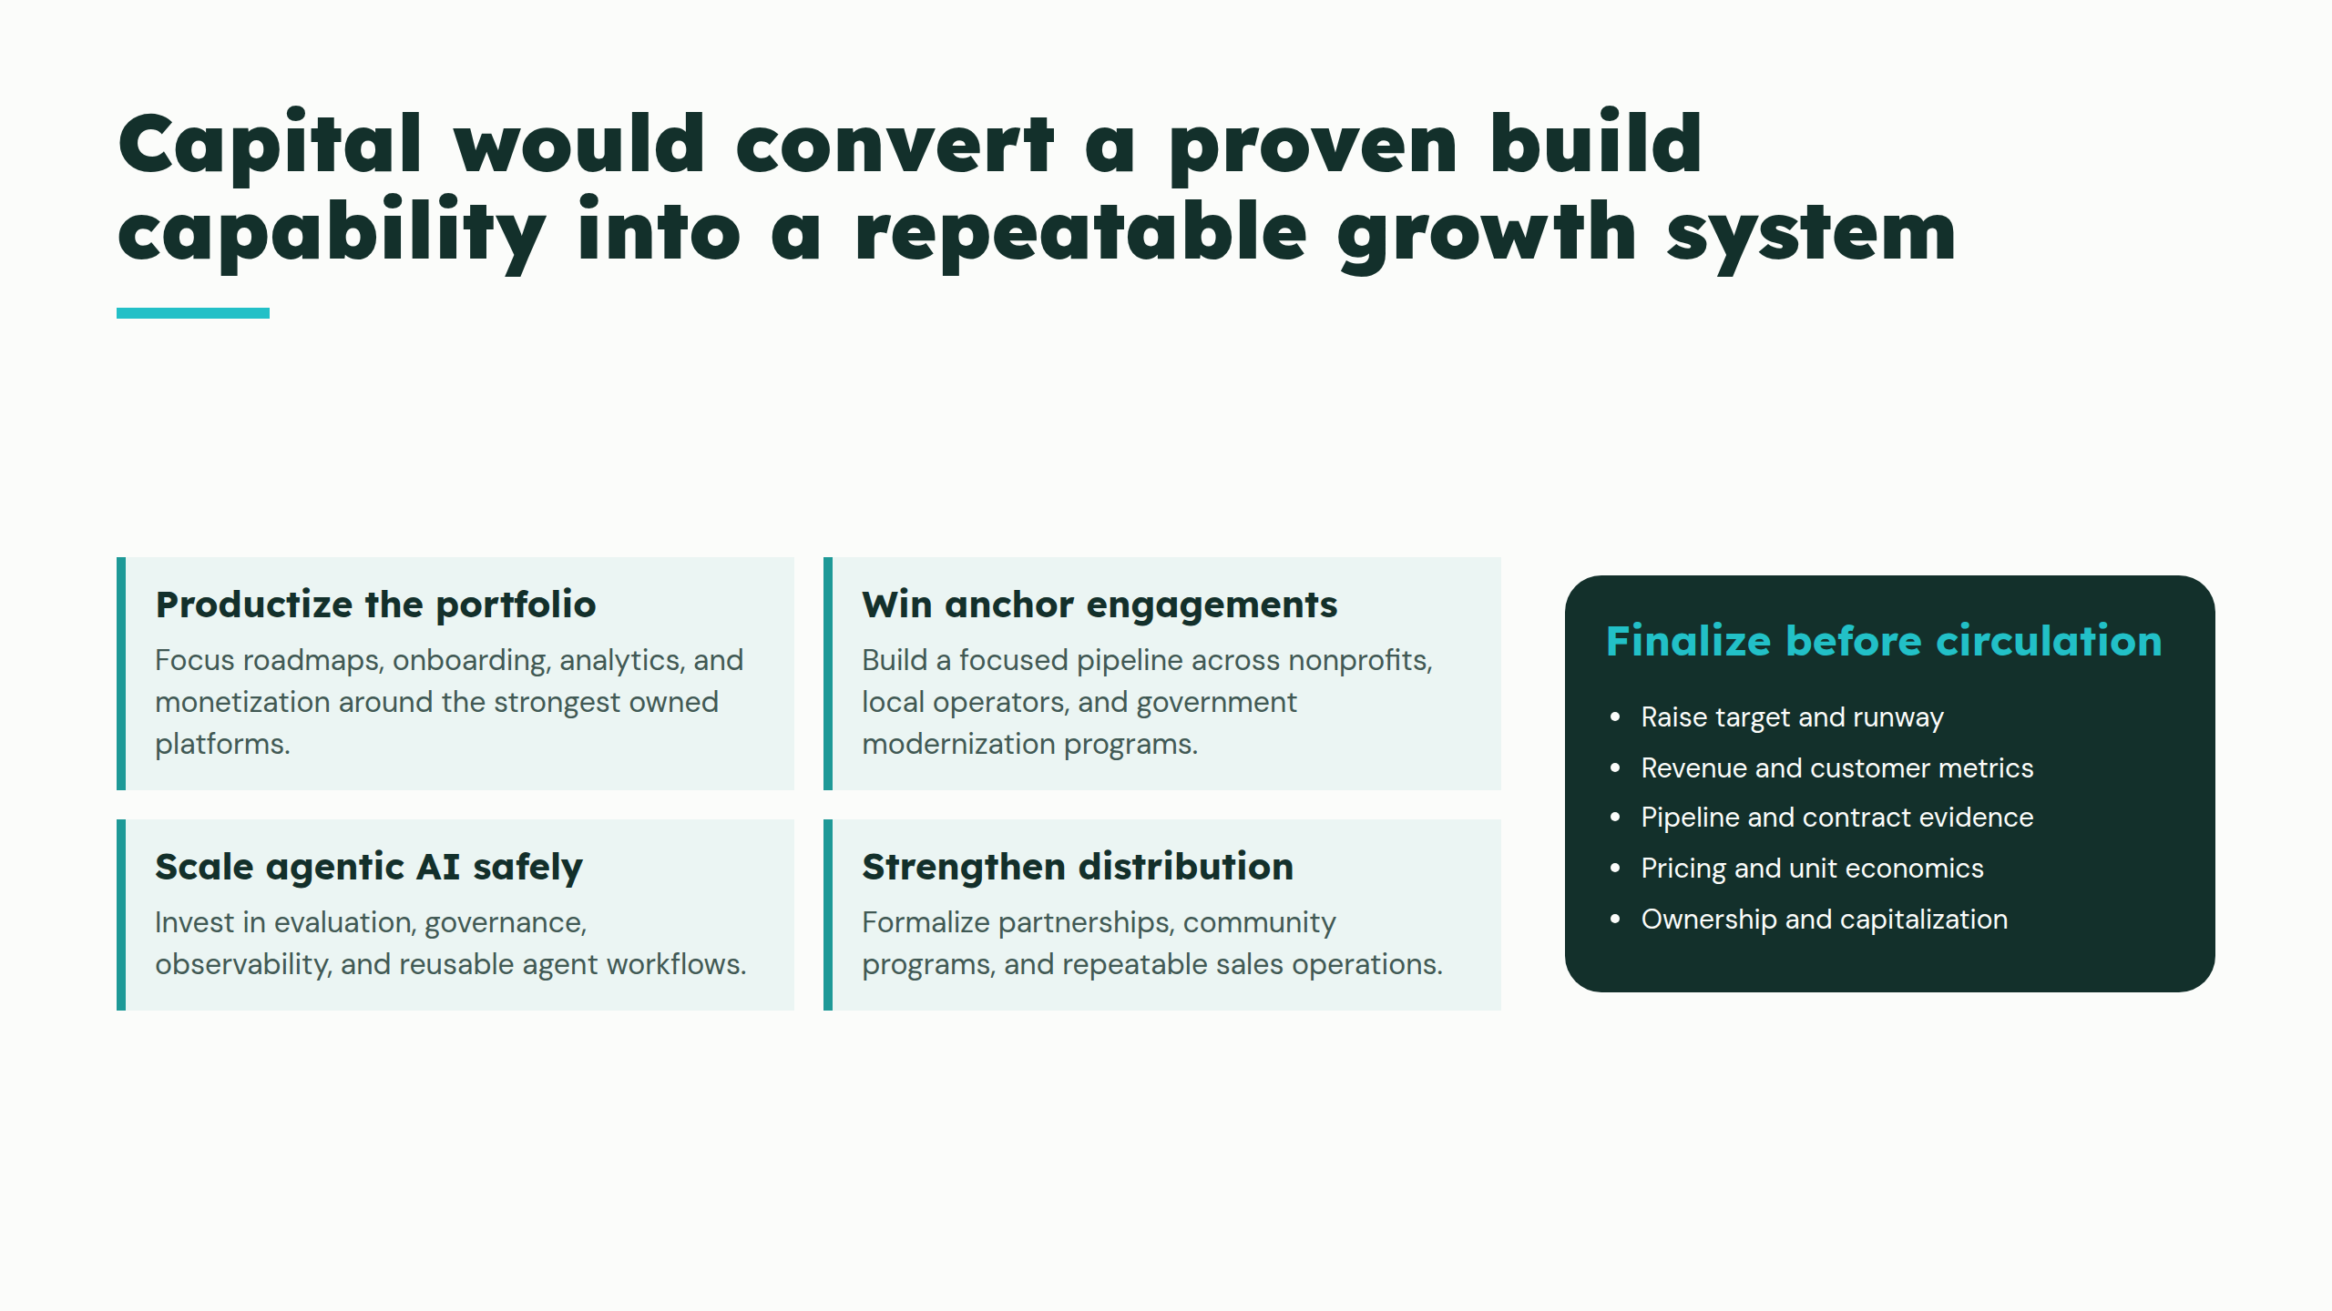
Notes:
Capital would convert a proven build capability into a repeatable growth system

Slide 11
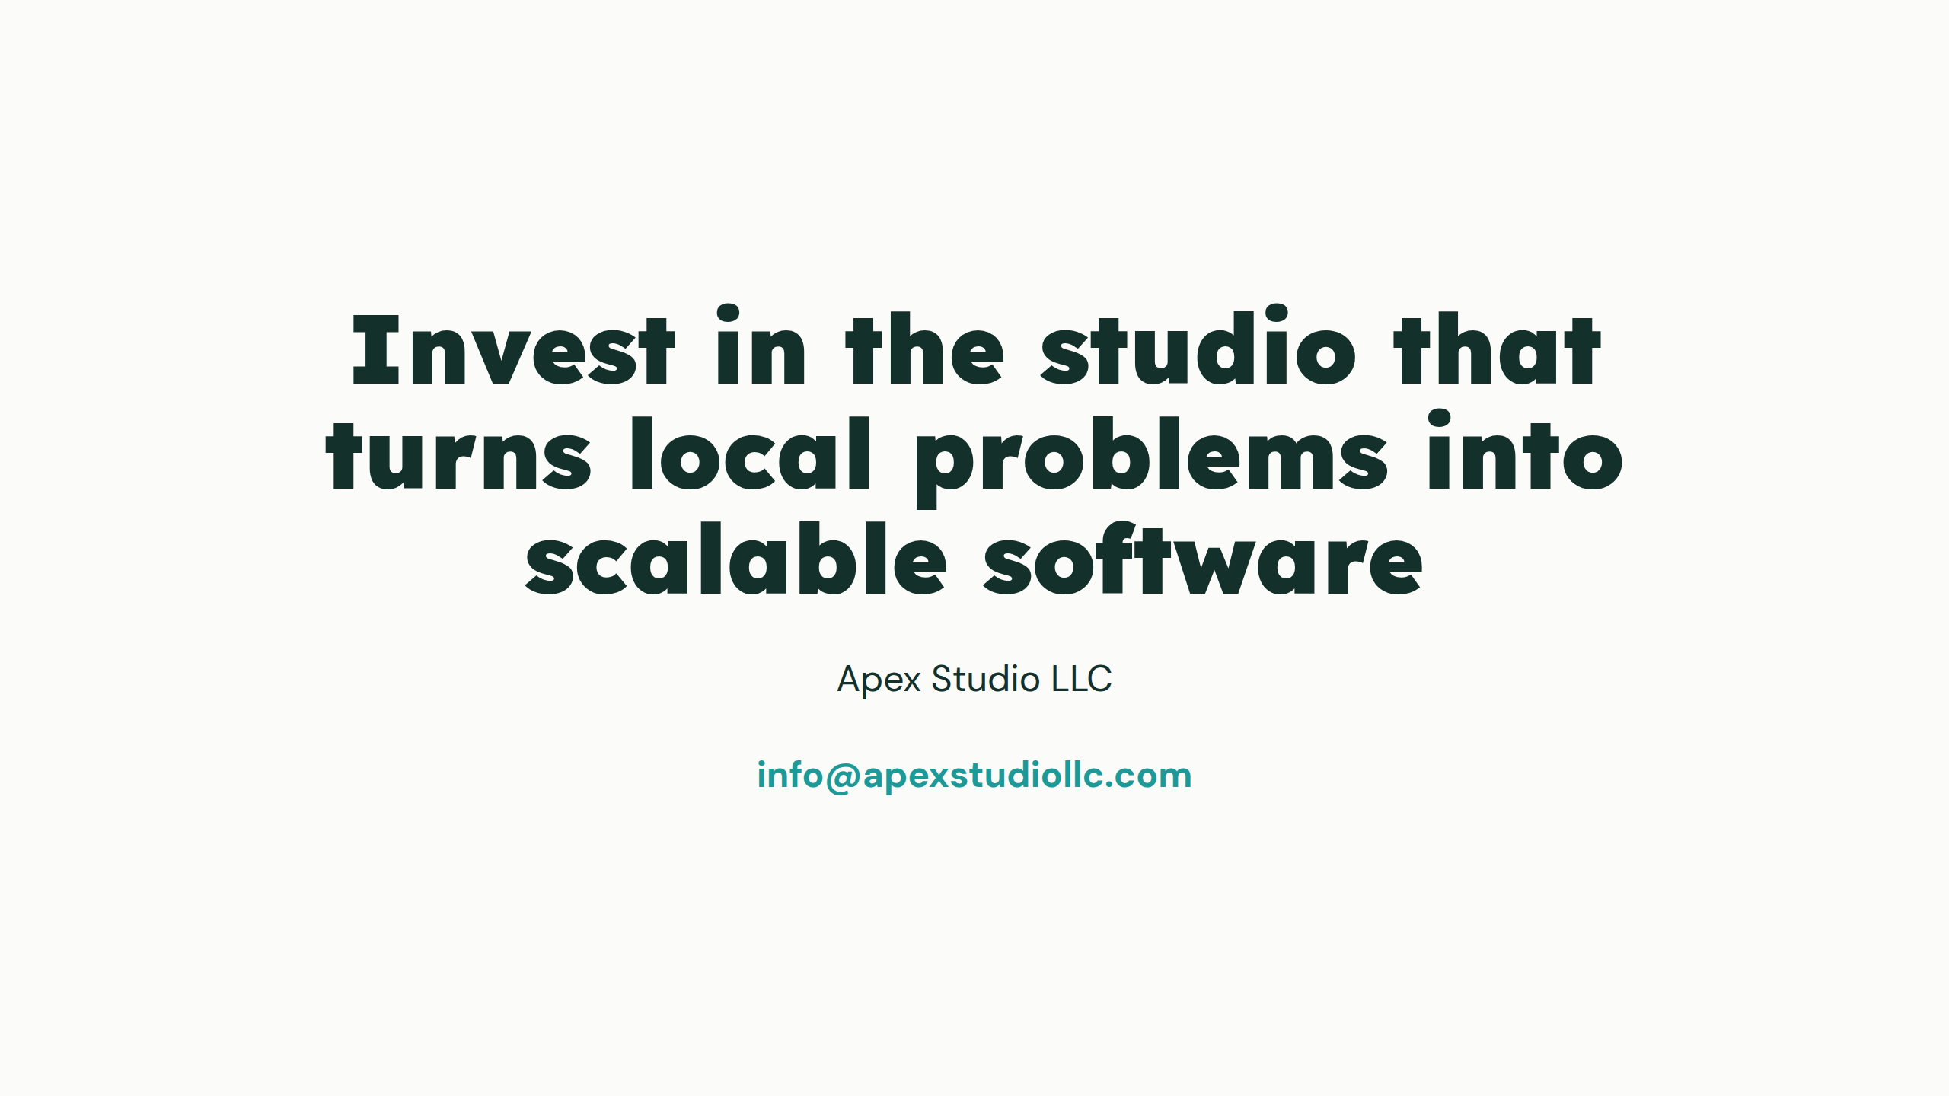
Notes:
Invest in the studio that turns local problems into scalable software

